Slide 1
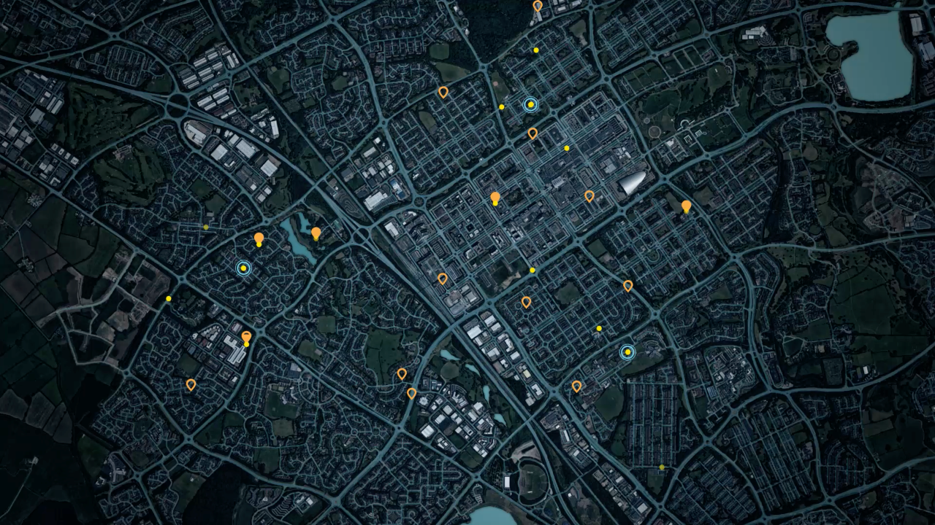

On-demand last-mile delivery service
using autonomous ground robots
Kristjan Korjus
Head of Computer Vision & Perception
kristjan.korjus@starship.xyz
+ 372 56840434

Slide 2
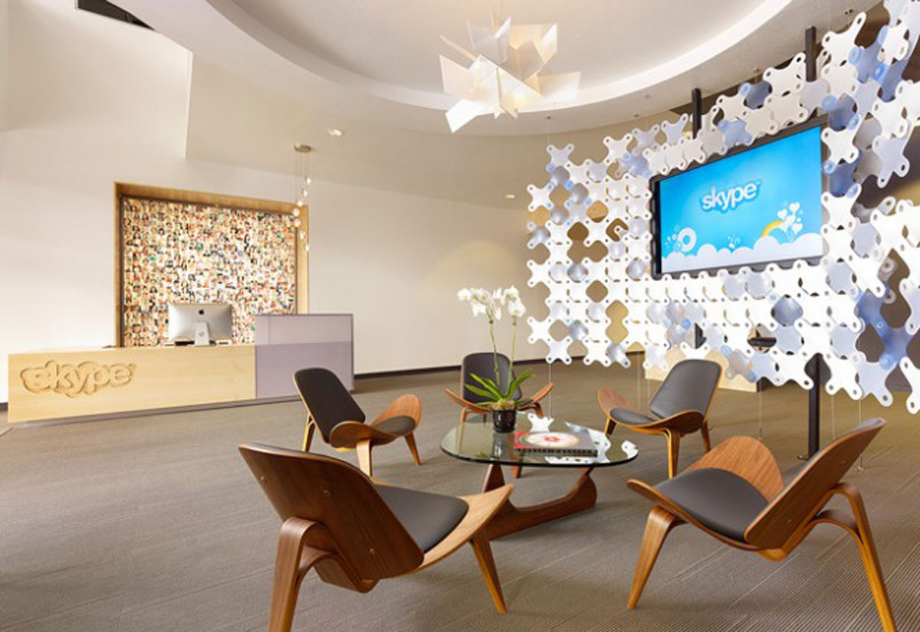
Notes:
Swede Niklas Zennström and the Dane Janus Friis

Slide 3

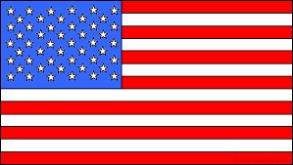
The last mile delivery
25 BILLION PACKAGES
130 BILLION PERSONAL
SHOPPING TRIPS
3 BILLION TAKEAWAY
FOOD DELIVERIES
Notes:
LAST MILE DELIVERY – POTENTIALLY, THE LARGEST INDUSTRY IN THE WORLD THAT IS NOT YET DISRUPTED BY TECHNOLOGY

Slide 4
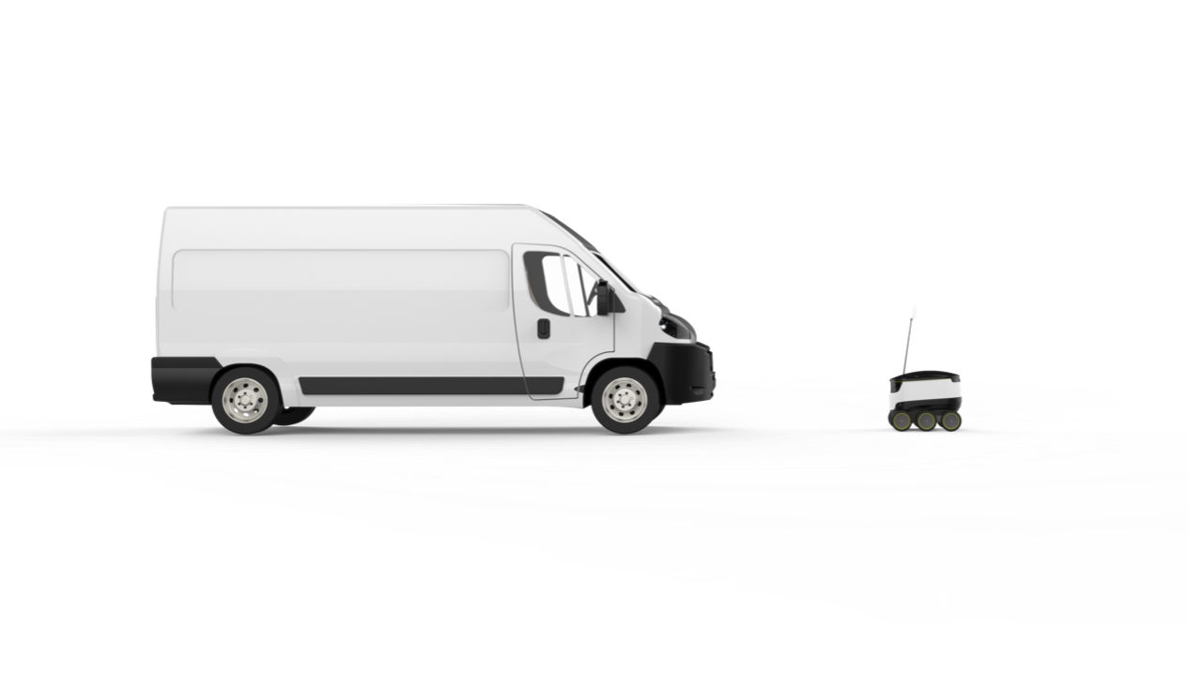


The last mile problem
Notes:
80% of cost on last mile because 1 package at a time
1 hour lost per family per day on personal shopping trips
Customers are not happy as deliveries are not on-demand
It’s time to disrupt the trillion dollar delivery industry. One of the last large industries. EU USA: 25 BILLION PACKAGES, 3 billion on demand food deliveries

Slide 5
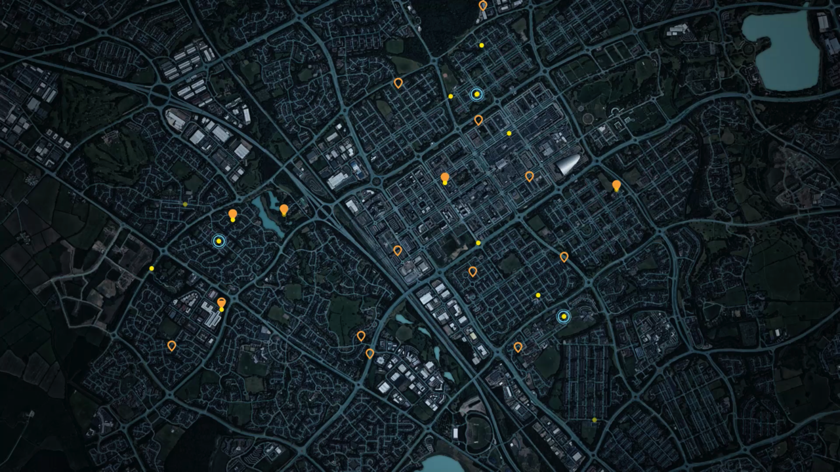
OUR MISSION
TO BUILD THE WORLD’S MOST EFFICIENT
LOCAL ON-DEMAND DELIVERY SERVICE

Slide 6
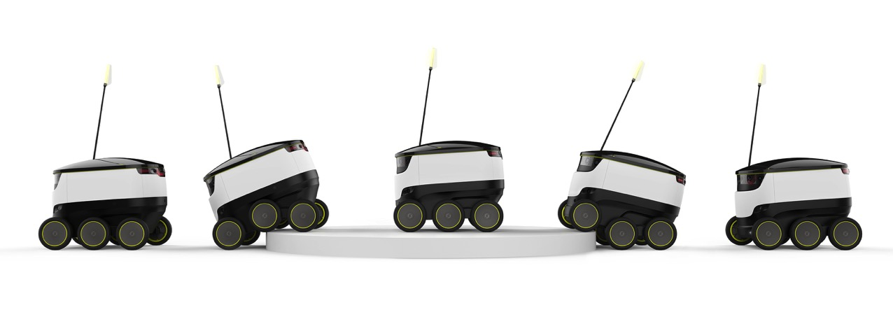
A COMPANY WITH ROOTS IN SKYPE
Leader of the emerging industry of ground-based delivery robots
Running commercial service and pilots with >10 partners and >100 robots
Operations in the Bay Area, Washington, DC, Arkansas, London, Hamburg, Bern,
R&D in Estonia
Started by
Skype
co-founders
140 employees, many coming from Skype

Slide 7
REAL LIFE MILESTONES
120
51 000
63 CITIES
6 MILLION
Robots produced
Km driven on public sidewalks
The robot has been tested in
People have encountered our robots on sidewalks
As of May 19, 2017

Slide 8
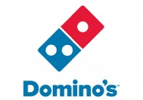

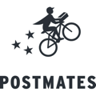








SELECTED COOPERATION PARTNERS

Slide 9
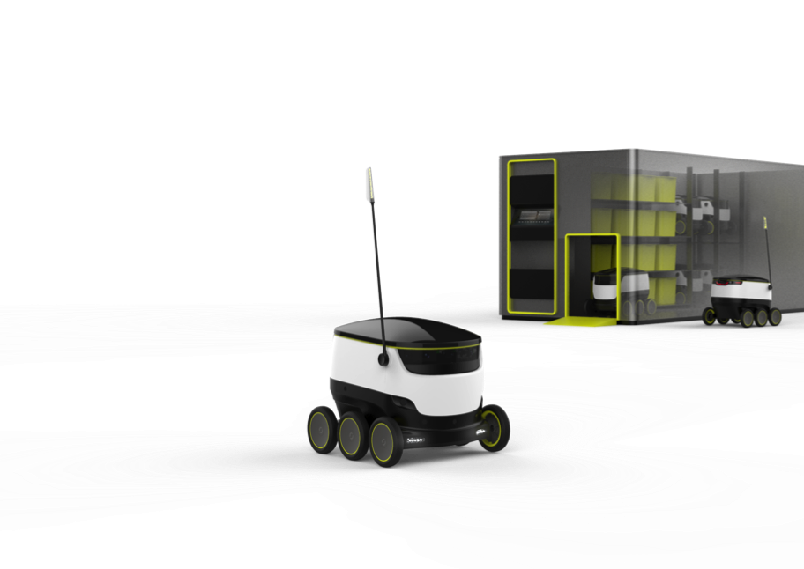
OUR BUSINESS MODEL
Delivery service for neighborhoods using fleets of autonomous sidewalk robots
Focusing on takeaway food, groceries and package delivery
B2B2C business model: We deliver to end users on behalf of business partners
Providing convenient on-demand delivery
in 1-2 mile radius in 30-45 minutes
Pay-as-you-go, per-delivery pricing

Slide 10
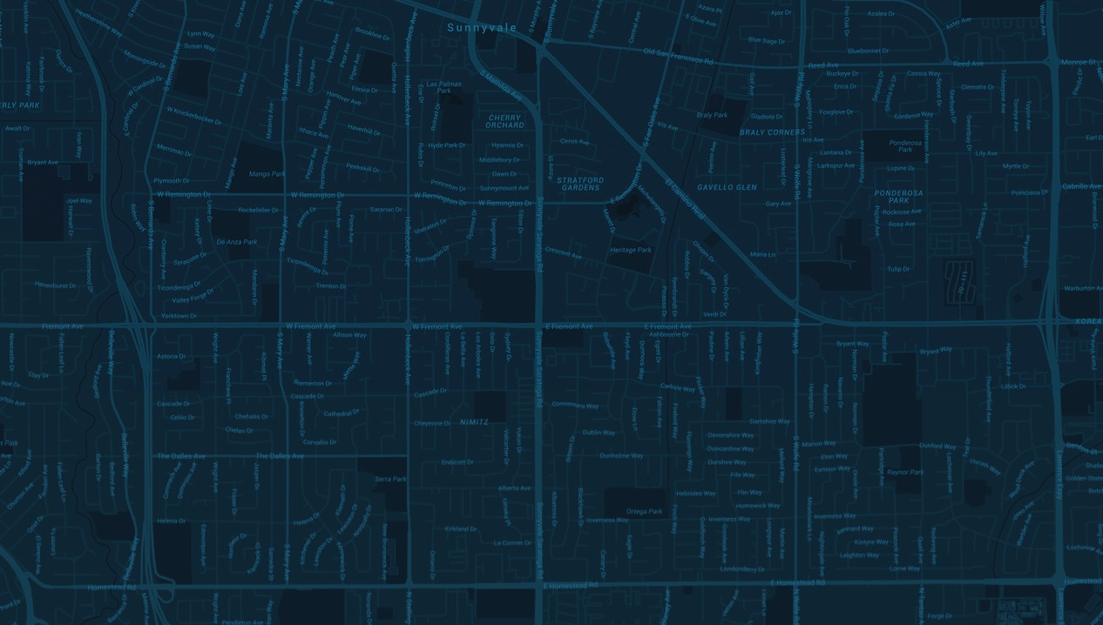
2 miles
HOW IT WORKS
LOCAL DELIVERY PLATFORM
Starship installs robotic fleets in 1 – 10 square mile neighborhoods, ensuring 30-minute deliveries in max
2-mile radius
10 – 30 deliveries per day per robot
Size and shape of catchment area depend on delivery density, sidewalk networks, store locations etc.
10,000 HOUSEHOLDS
25,000 PEOPLE
ADDRESSABLE MARKET:
5-10,000
DAILY
DELIVERIES
2 miles
Sunnyvale, CA

Slide 11
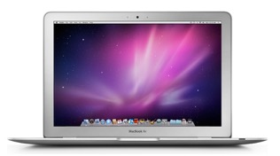
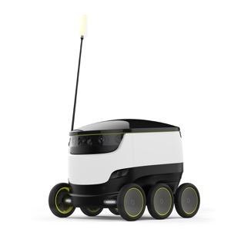

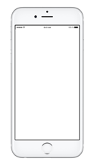
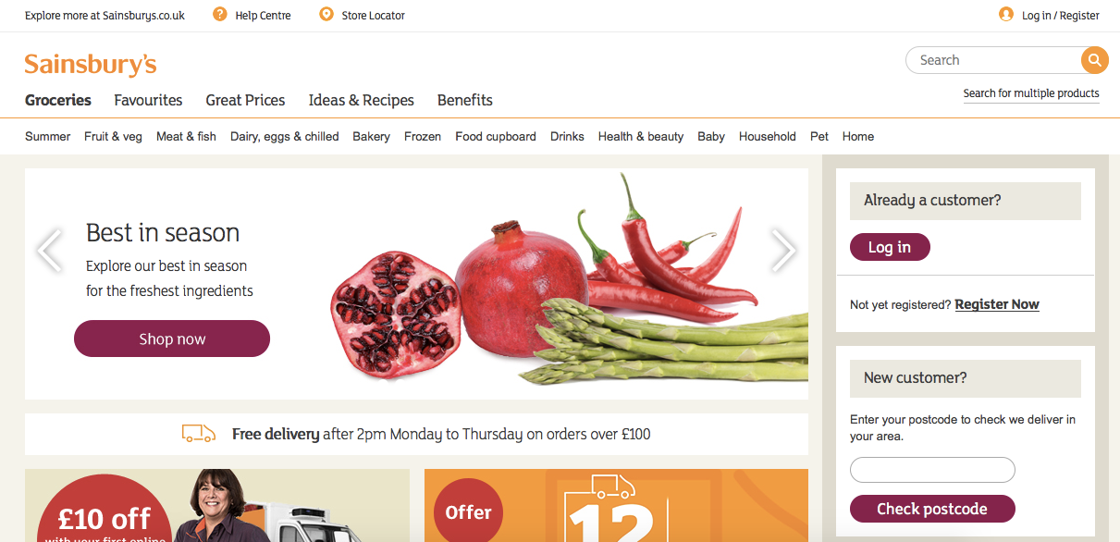
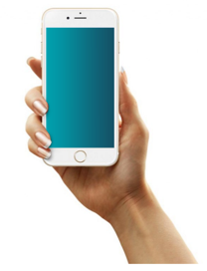
HOW STARSHIP WORKS
CONSUMER´S PERSPECTIVE
3 deliveries
Pending
ok
8.05
8:10
8:15
8:20
8:25
8:30
8:35
8:40
8:50

Slide 12
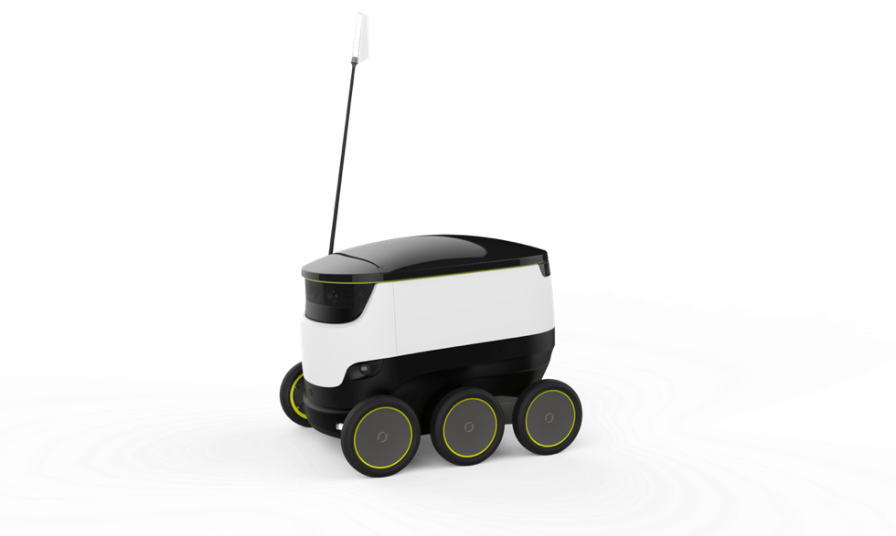
WHAT IS THE DELIVERY ROBOT?
An personal delivery device (PDD) that uses sidewalks
Drives at pedestrian speeds, max 6 km/h
Equipped with 9 cameras, 4 radars, 8 ultrasonic and many other sensors
Navigates with 2 cm precision
Can intelligently react to pedestrians, obstacles and traffic situations
Robotic fleets are monitored by human operators who can take over the control any time
Carries max 10 kg or an equivalent of 3 shopping bags
Inherently safe

Slide 13
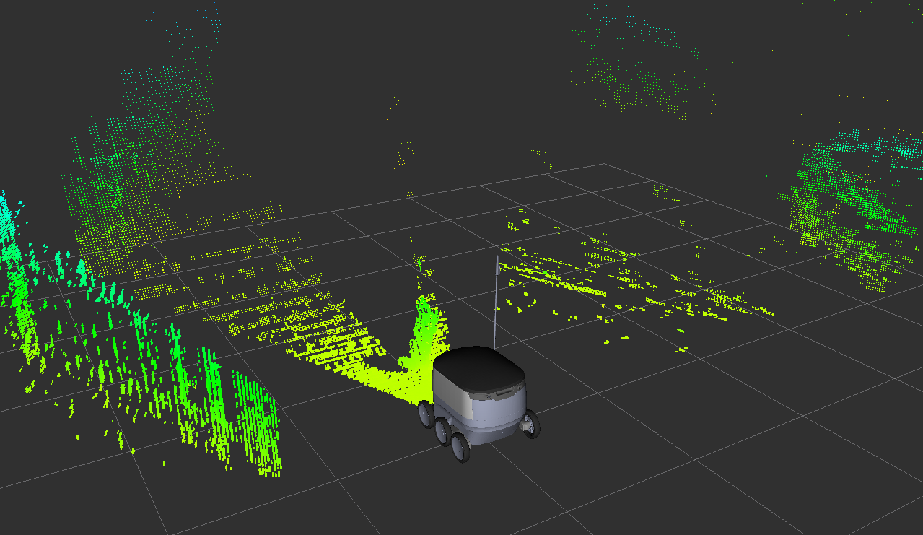

Slide 14
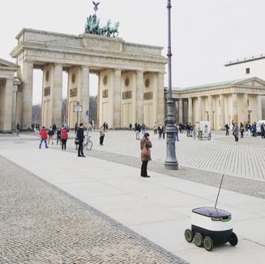
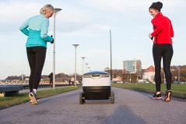
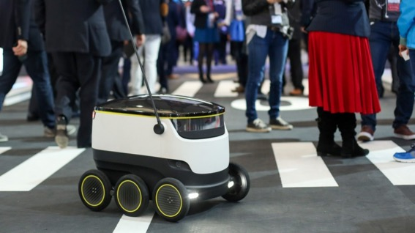
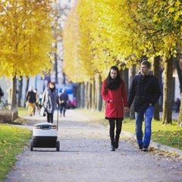
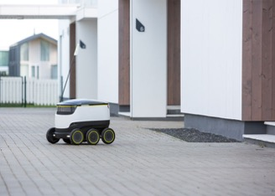
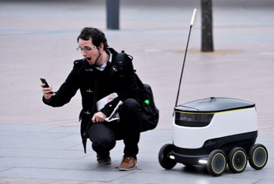
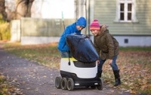
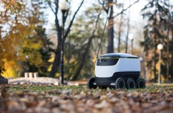
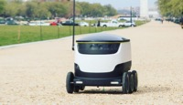
TESTING THE ROBOT
Notes:
First, social robots, children batting, bananas, sitting, no problems with dogs.
73% of people notice the robot
But only 1% asks anything
Zero attempts of theft or vandalism

Slide 15
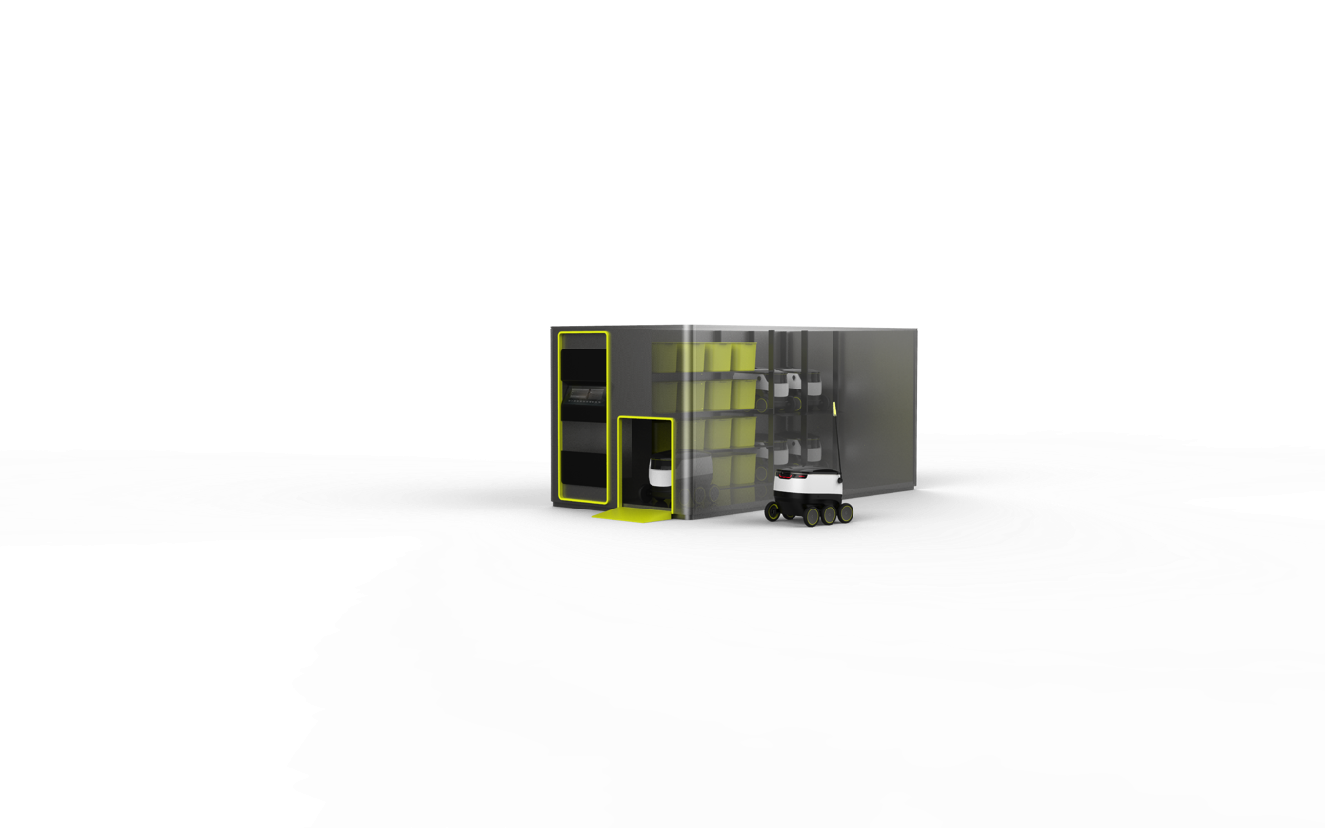
HUB
An automated warehouse allowing automatic loading, charging and cleaning of the robots
Optimized for higher delivery volumes (100+ packages
per day, 5+ robots)

Slide 16
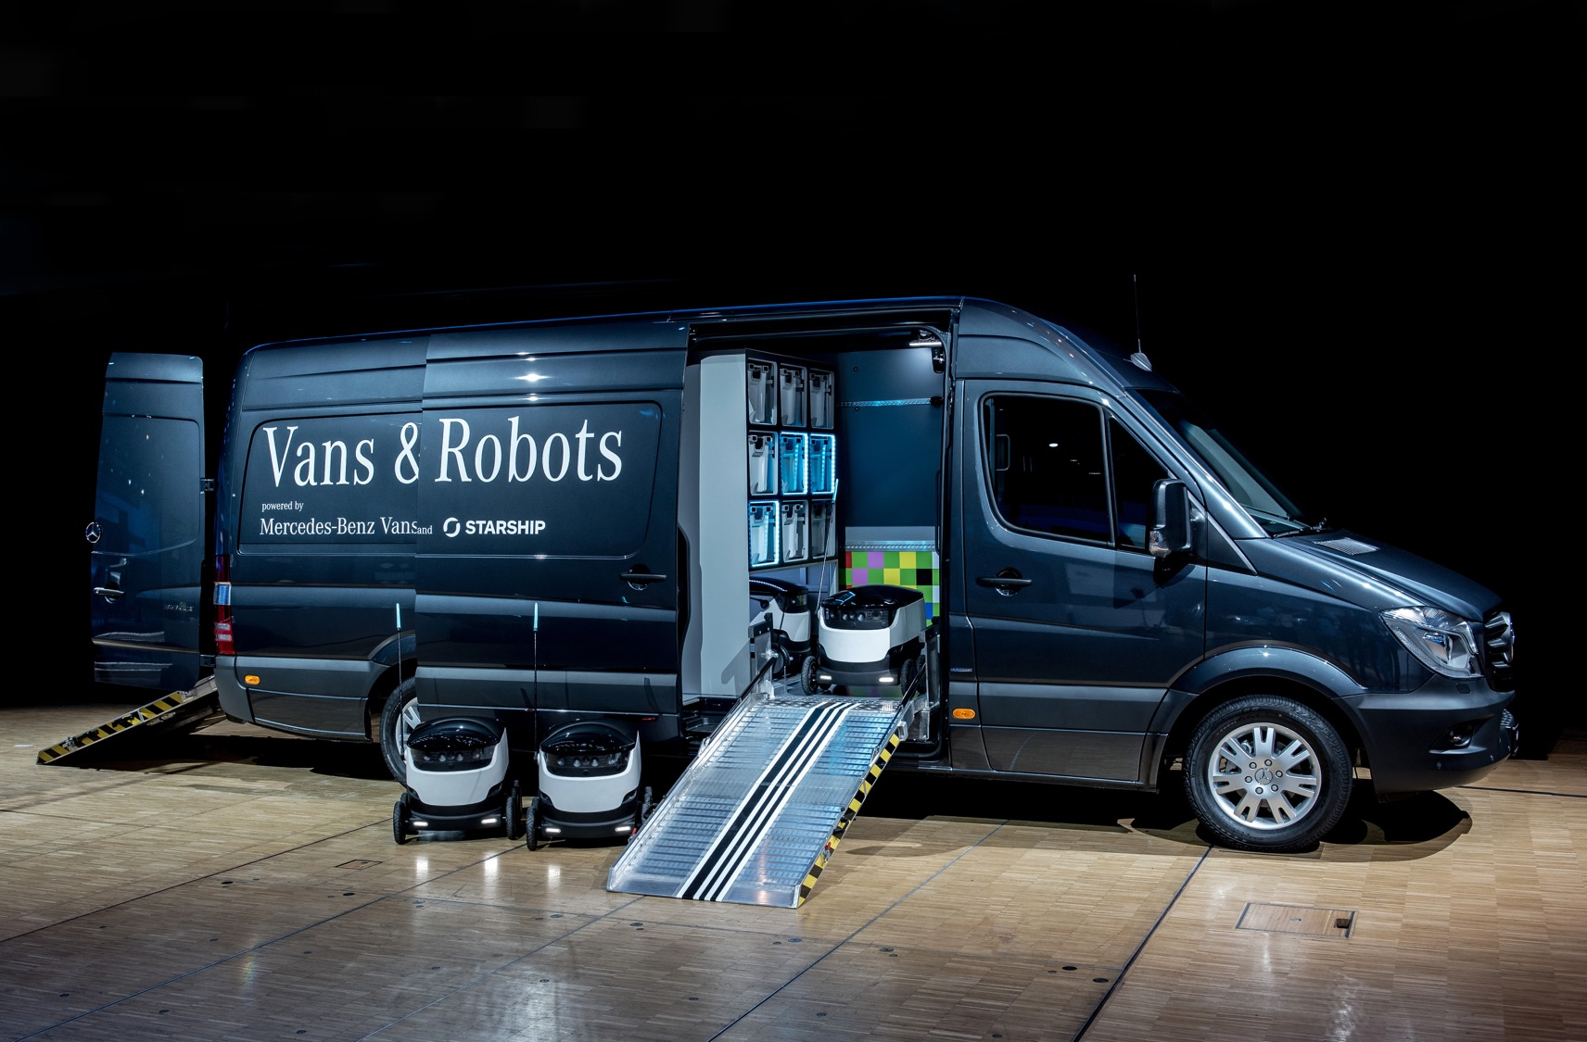
ROBOVAN PROJECT WITH MERCEDES-BENZ

Slide 17
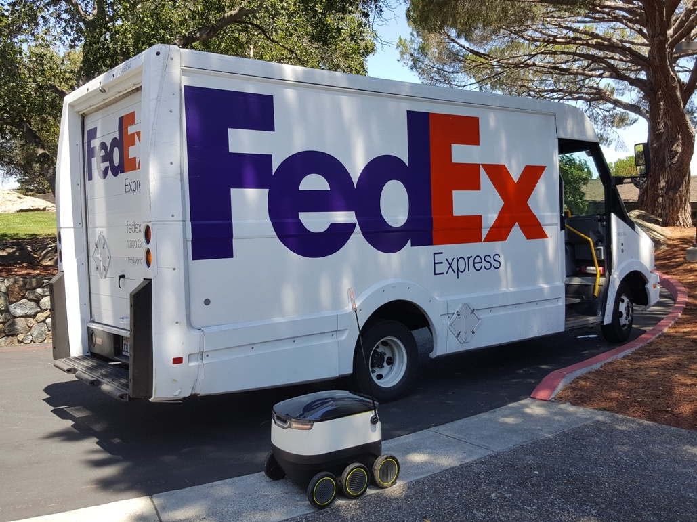
HOW DELIVERY ROBOTS WILL TRANSFORM CITIES
Reduced congestion
Reduced pollution
Zero emissions
Increase in quality of life
Assisting senior citizens
Affordable delivery for local businesses
Notes:
Genuine social and economic benefits of delivery robots
E-commerce is growing at over 10% a year and that means more cars and more vans doing deliveries which is causing problems
We want to offer on-demand delivery for $1 in the future,
Delivery is currently a hassle. We have to think about it, where will we be etc. We want to make it seamless.

Slide 18
On-demand last-mile delivery service
using autonomous ground robots
Kristjan Korjus
Head of Computer Vision & Perception
kristjan.korjus@starship.xyz
+ 372 56840434

